Slide 1
Managing the Cultural Record in the Information Warfare Era Clifford Lynch, U.C. Berkeley
Slides: Justin Whitlock
6 March 2019

Slide 2
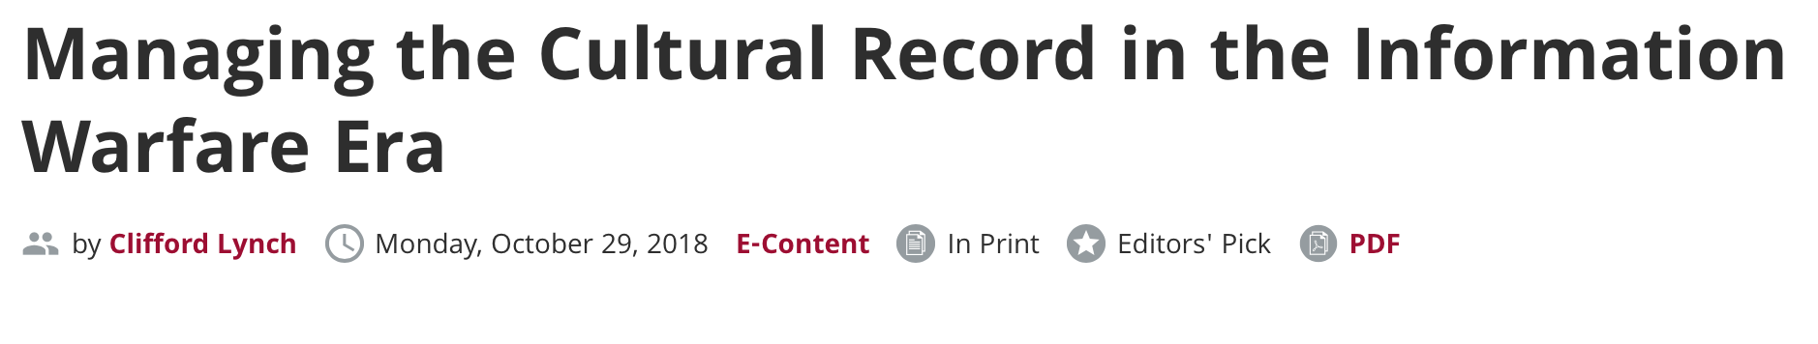
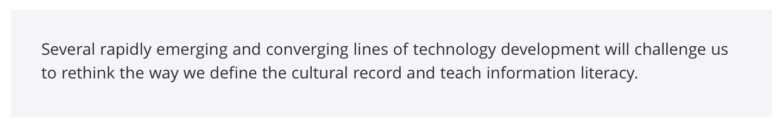
https://web.archive.org/web/20190128083058/https://er.educause.edu/articles/2018/10/managing-the-cultural-record-in-the-information-warfare-era

Slide 3
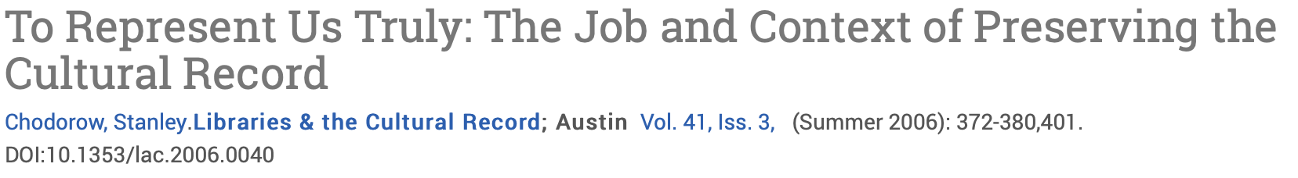
What belongs in our Cultural Record?
https://search.proquest.com/docview/222565595?pq-origsite=gscholar

Slide 4
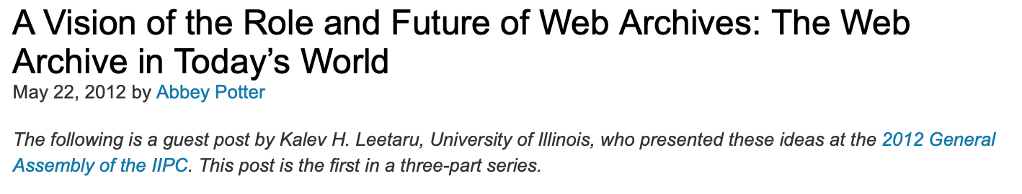
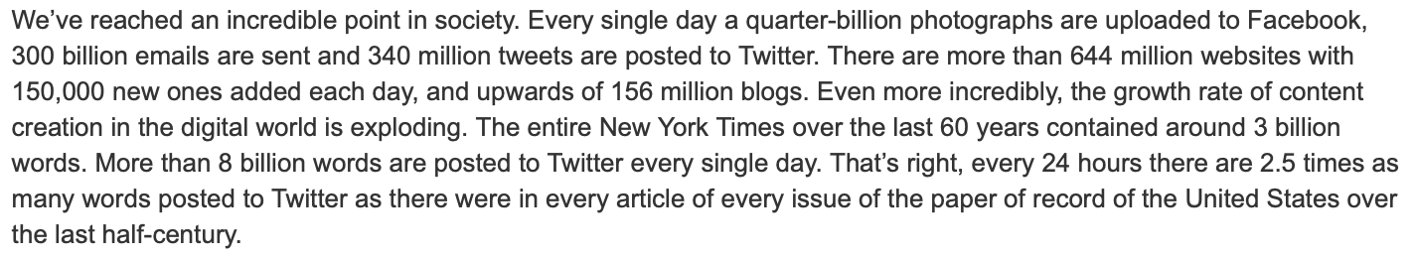
More and more, the cultural record is digital, and growing
https://blogs.loc.gov/thesignal/2012/05/a-vision-of-the-role-and-future-of-web-archives-the-web-archive-in-todays-world/

Slide 5
Digital archives are susceptible to advances in digital forgery technology
Deep fake audio/video methods
Social media manipulation
Insertion of false evidence into legitimate sources
Either reduces trust in legitimate sources,
Or it can mislead scholars into claims based on false evidence.

Slide 6
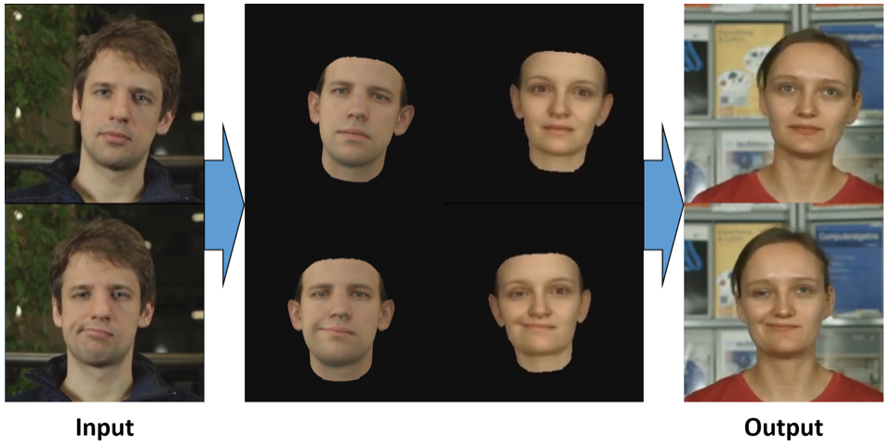
Deep fakes allow advanced manipulation of audio/video
https://web.archive.org/web/20190212022828/https://web.stanford.edu/~zollhoef/papers/SG2018_DeepVideo/page.html

Slide 7
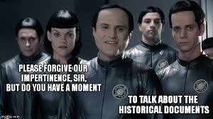
Skepticism is learned: Default setting is to believe what we see and hear.
https://www.imdb.com/title/tt0177789/

Slide 8
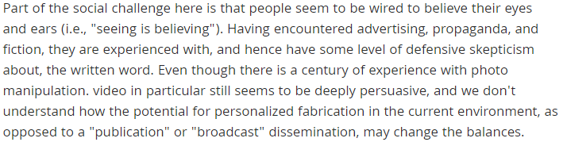
The meaning of information literacy needs to change
https://web.archive.org/web/20190128083058/https://er.educause.edu/articles/2018/10/managing-the-cultural-record-in-the-information-warfare-era

Slide 9
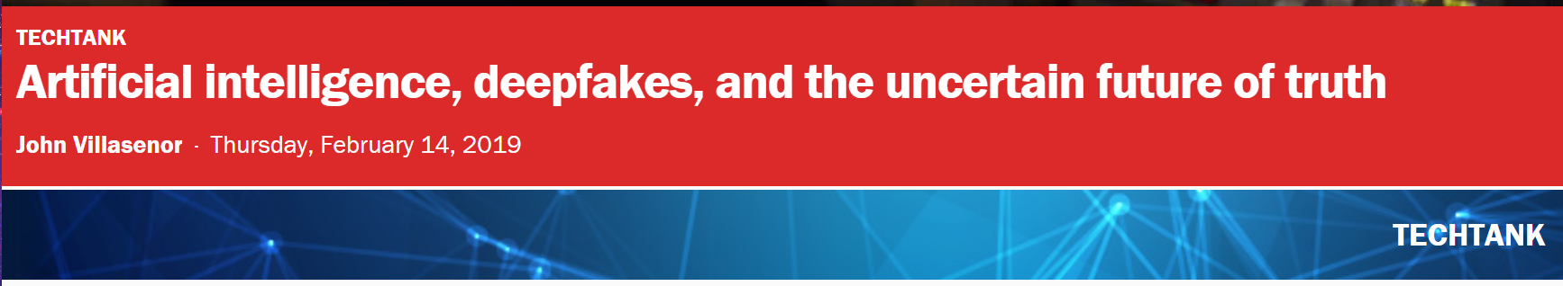
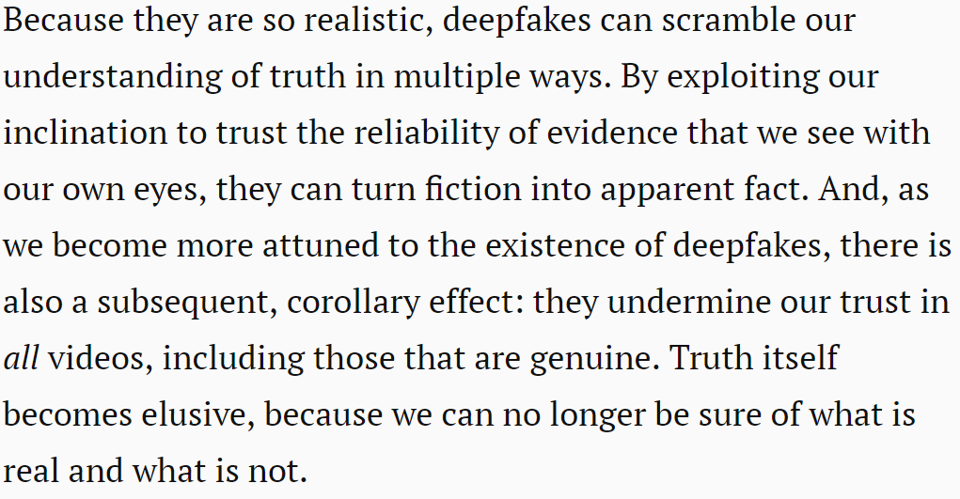
Awareness of DeepFakes Erodes Trust
https://www.brookings.edu/blog/techtank/2019/02/14/artificial-intelligence-deepfakes-and-the-uncertain-future-of-truth/
https://papers.ssrn.com/sol3/papers.cfm?abstract_id=3213954

Slide 10
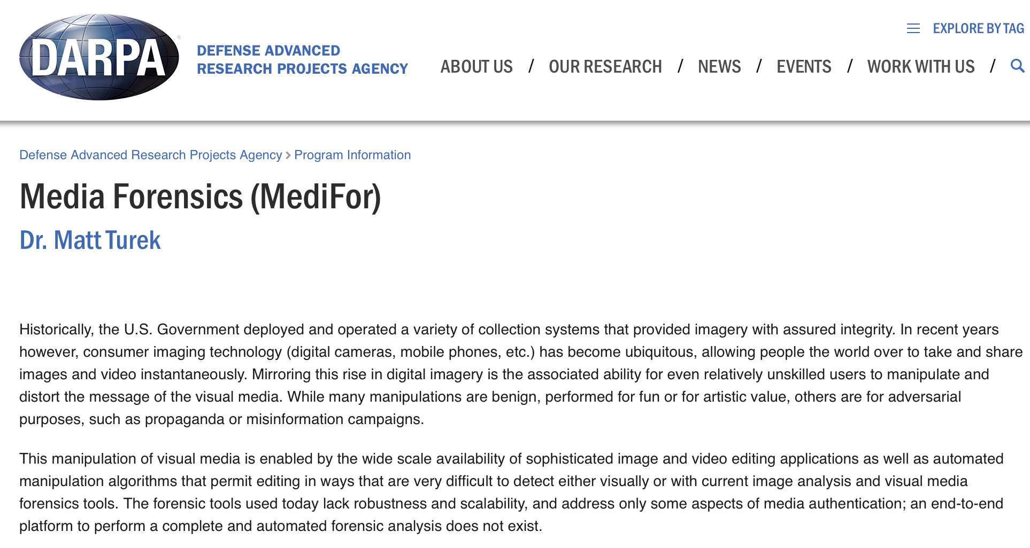
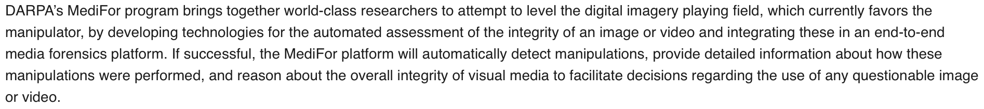
As digital forgeries grow more advanced, we need more advanced tools to detect them.
https://www.darpa.mil/program/media-forensics

Slide 11
Misinformation and fake news enter a new era with social media
“In addition, a separate and important set of issues concerns how fabricated material broadly (whether old-fashioned text materials or new digital fabrications) is introduced to the public sphere and subsequently promoted and given visibility and credibility (e.g., through manipulating social media system mechanisms or by subverting what are viewed as "official" channels).”
https://web.archive.org/web/20190128083058/https://er.educause.edu/articles/2018/10/managing-the-cultural-record-in-the-information-warfare-era

Slide 12
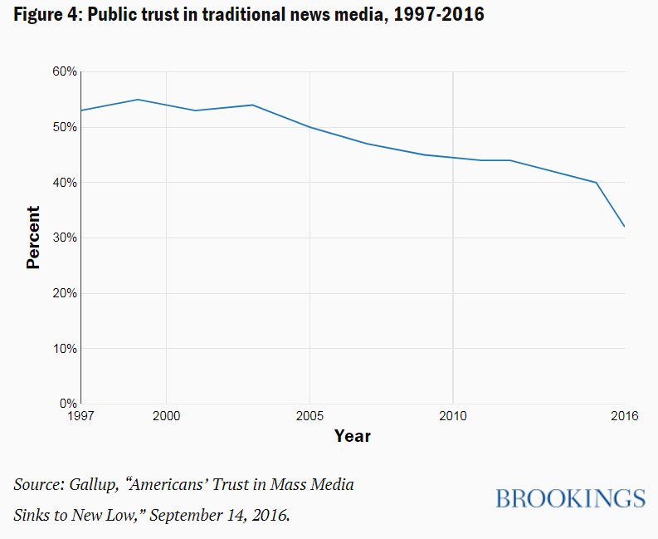
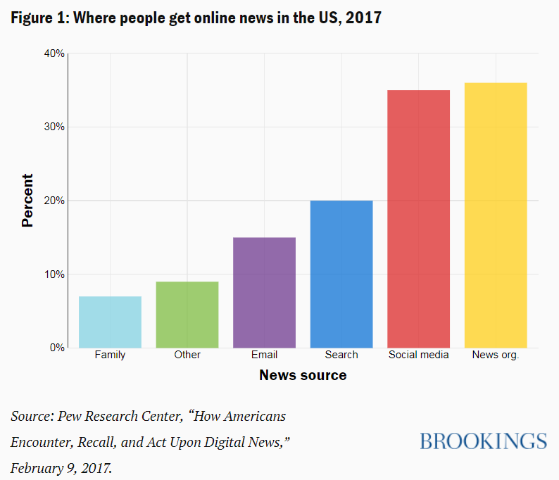
Dissemination of Fake News over Social Media
https://www.brookings.edu/research/how-to-combat-fake-news-and-disinformation/

Slide 13
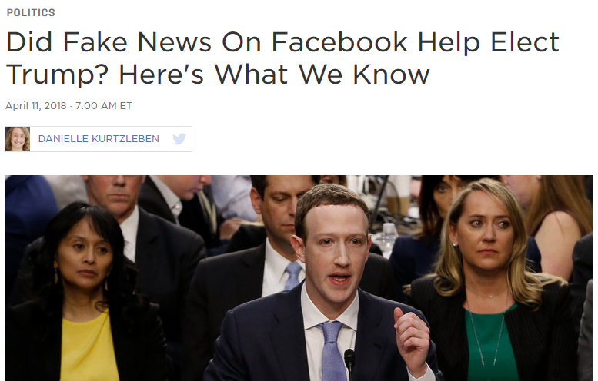
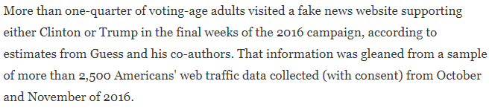
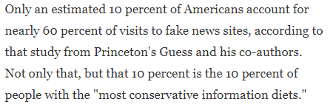
While widespread, how to measure its impact?
https://www.npr.org/2018/04/11/601323233/6-facts-we-know-about-fake-news-in-the-2016-election

Slide 14
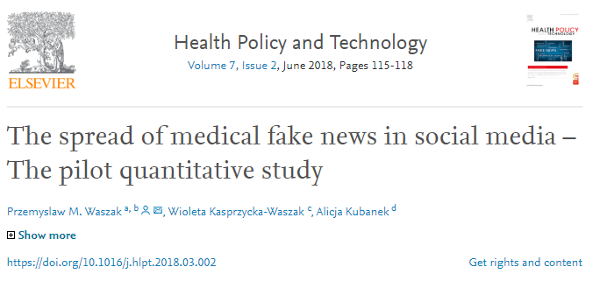
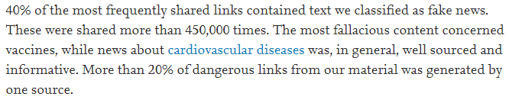
Impact of fake science news is easier to quantify
https://www.sciencedirect.com/science/article/pii/S2211883718300881

Slide 15
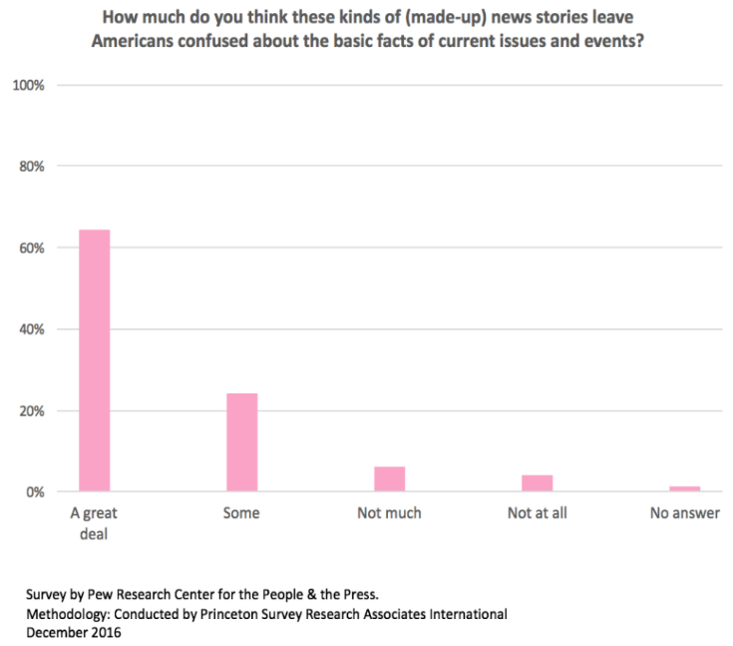
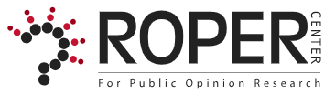
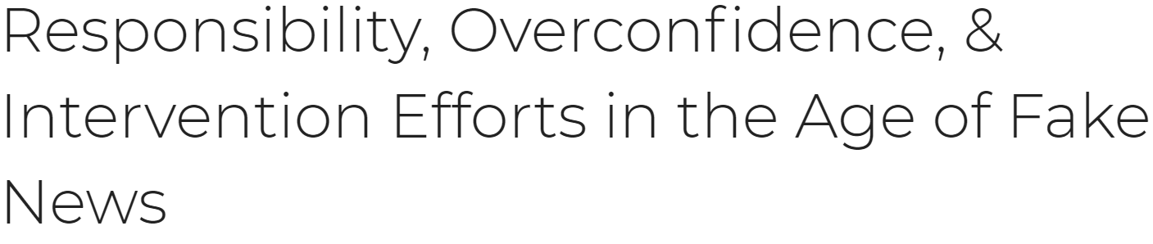
Whether or not it impacted the elections, people are rightly concerned.
https://ropercenter.cornell.edu/responsibility-overconfidence-intervention-efforts-age-fake-news

Slide 16
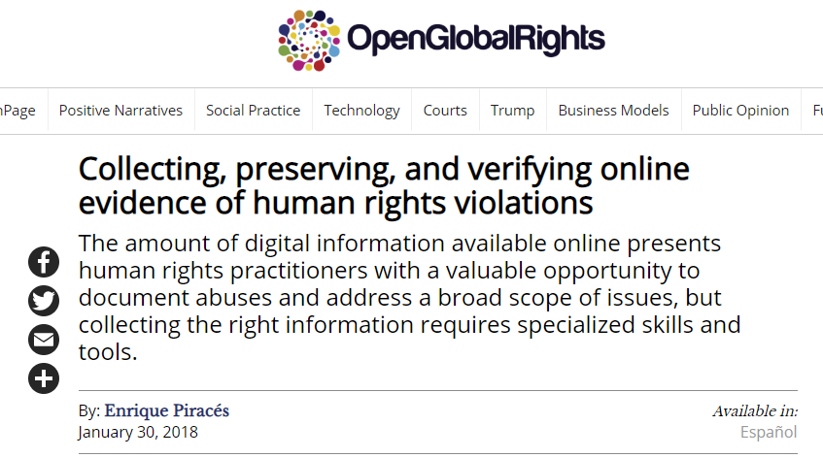
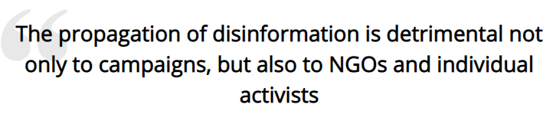
Individual activism could become even harder
https://www.openglobalrights.org/collecting-preserving-and-verifying-online-evidence-of-human-rights-violations/

Slide 17
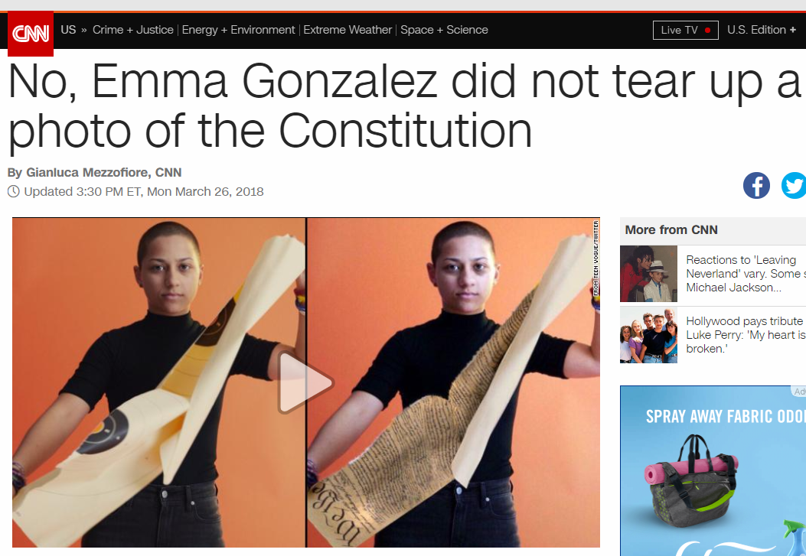
Activists attacked with fake news, how to verify the original?
https://web.archive.org/web/20190305214321/https://www.cnn.com/2018/03/26/us/emma-gonzalez-photo-doctored-trnd/index.html

Slide 18
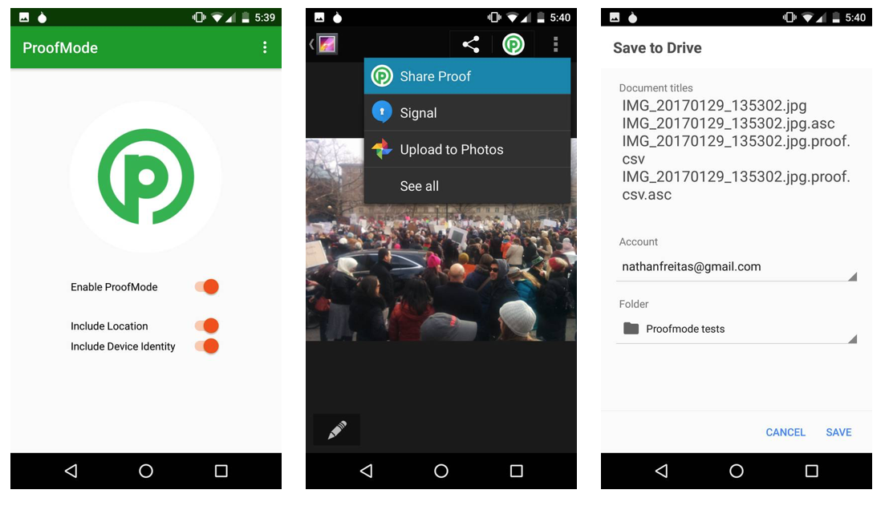
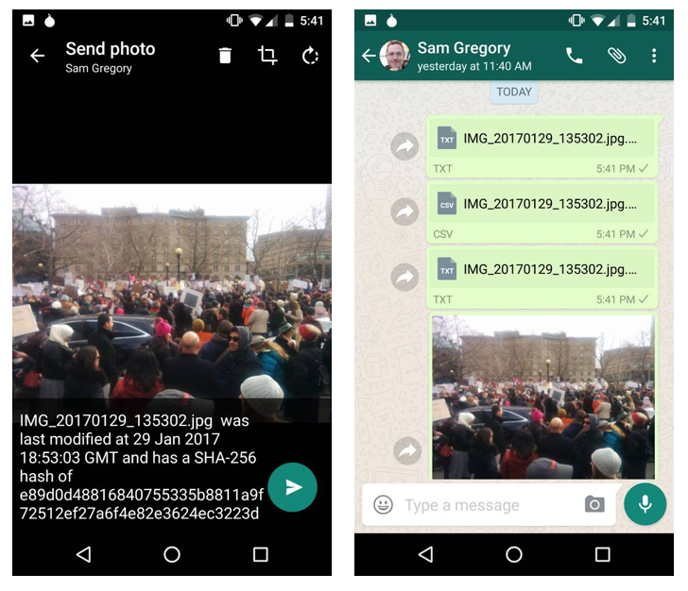
Verifying visual evidence by signing data at creation
https://guardianproject.info/2017/02/24/combating-fake-news-with-a-smartphone-proof-mode/

Slide 19
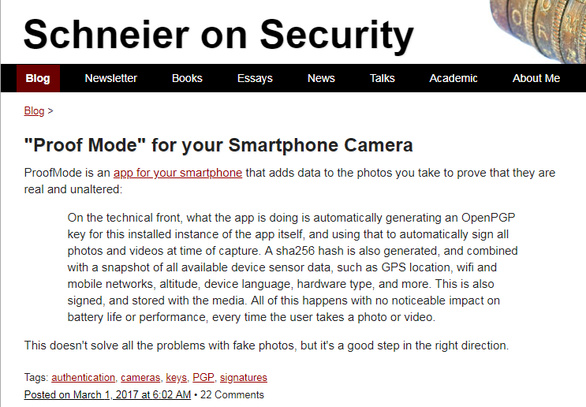
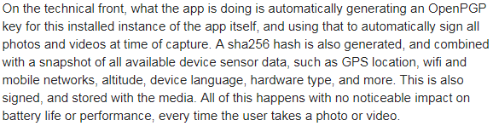
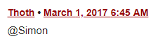
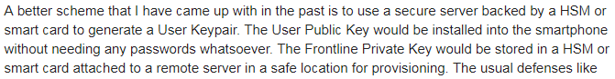
Proof Mode is not a perfect solution
https://www.schneier.com/blog/archives/2017/03/proof_mode_for_.html

Slide 20
When the official record is tampered with, who can you trust?
“While rewriting or populating the news with fake audio-visual material is likely to have the biggest impact on the public at large, we need to think through the potential impact of a subtly corrupted scientific record and the issue of how we will develop a generation of scholars who can question, recognize, and deal with this sort of intentional corruption.”
https://web.archive.org/web/20190128083058/https://er.educause.edu/articles/2018/10/managing-the-cultural-record-in-the-information-warfare-era

Slide 21
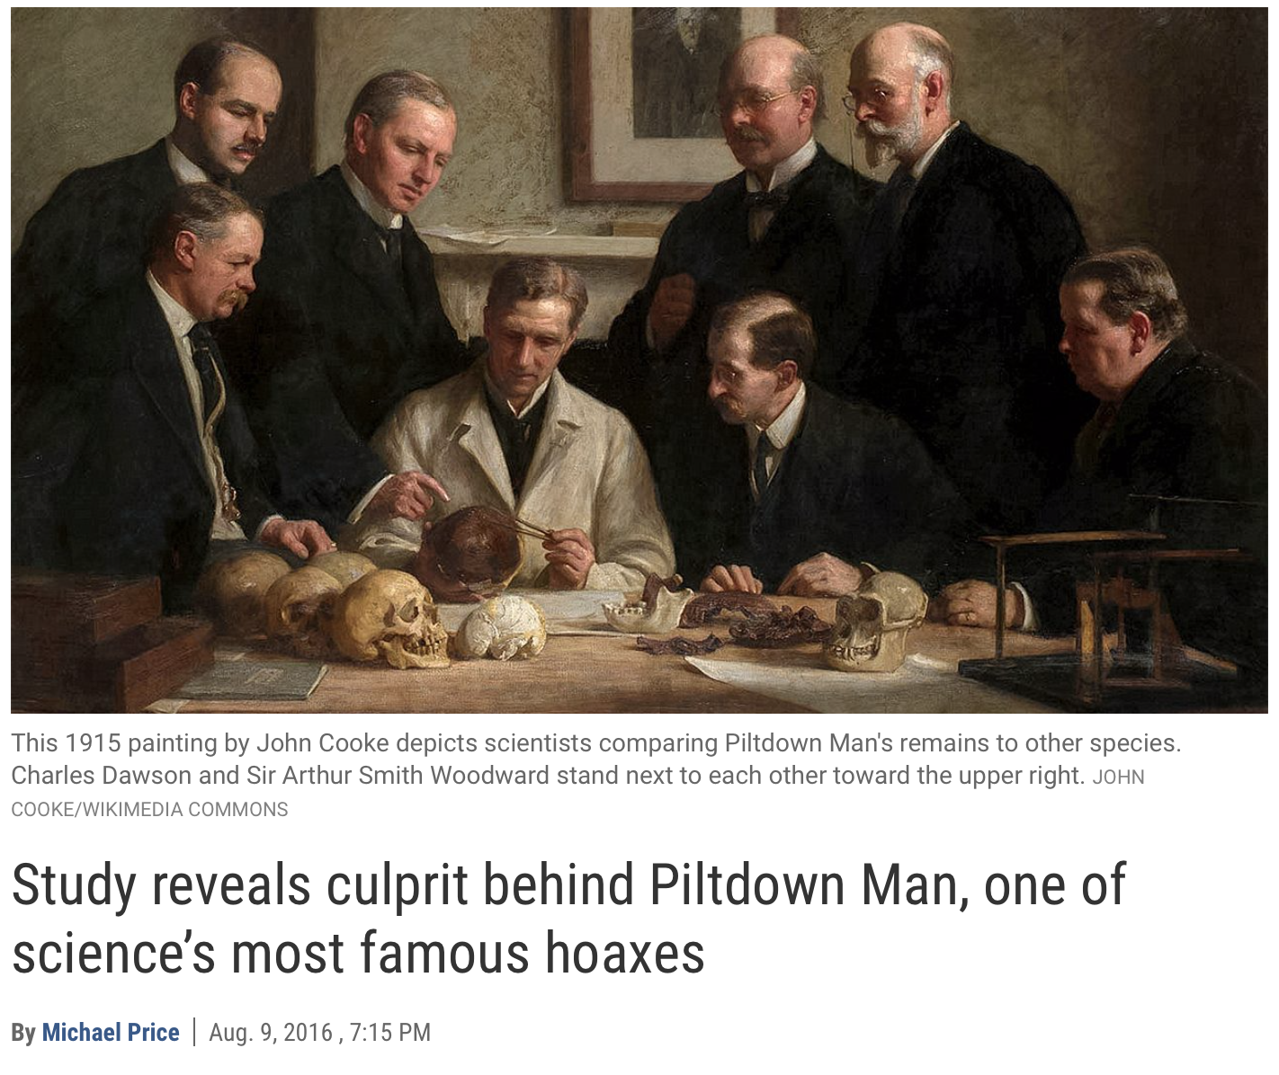
Physical forgeries slowed scientific advancement
https://web.archive.org/web/20180711202533/http://www.sciencemag.org/news/2016/08/study-reveals-culprit-behind-piltdown-man-one-science-s-most-famous-hoaxes
https://blogs.scientificamerican.com/anthropology-in-practice/the-missing-link-that-wasne28099t/

Slide 22
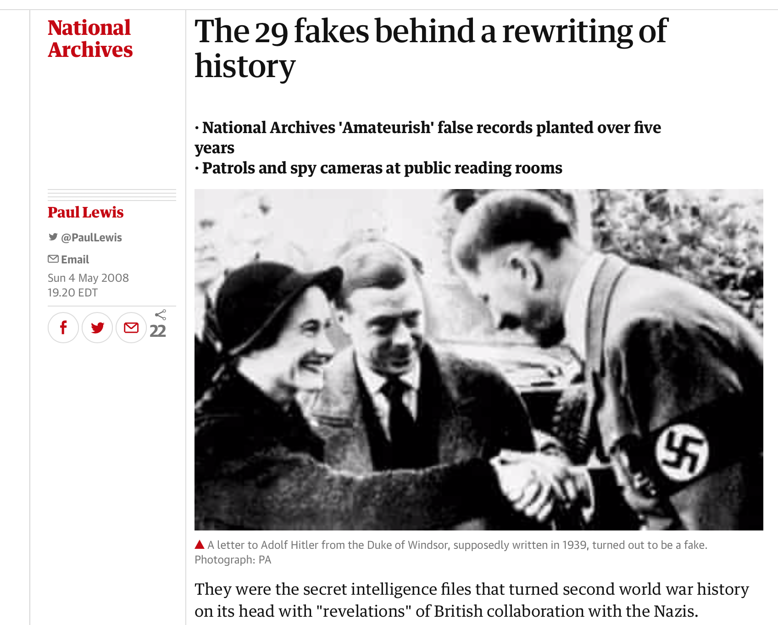
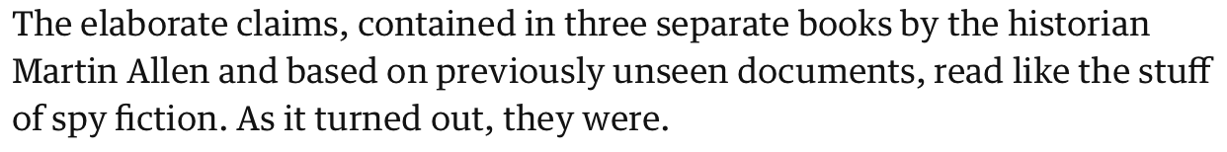
Insertion of false documents have affected non-digital archives in the past, as well as historical narrative
https://web.archive.org/web/20190104190702/https://www.theguardian.com/uk/2008/may/05/nationalarchives.secondworldwar

Slide 23
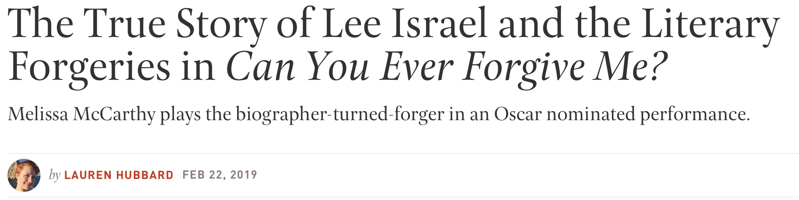
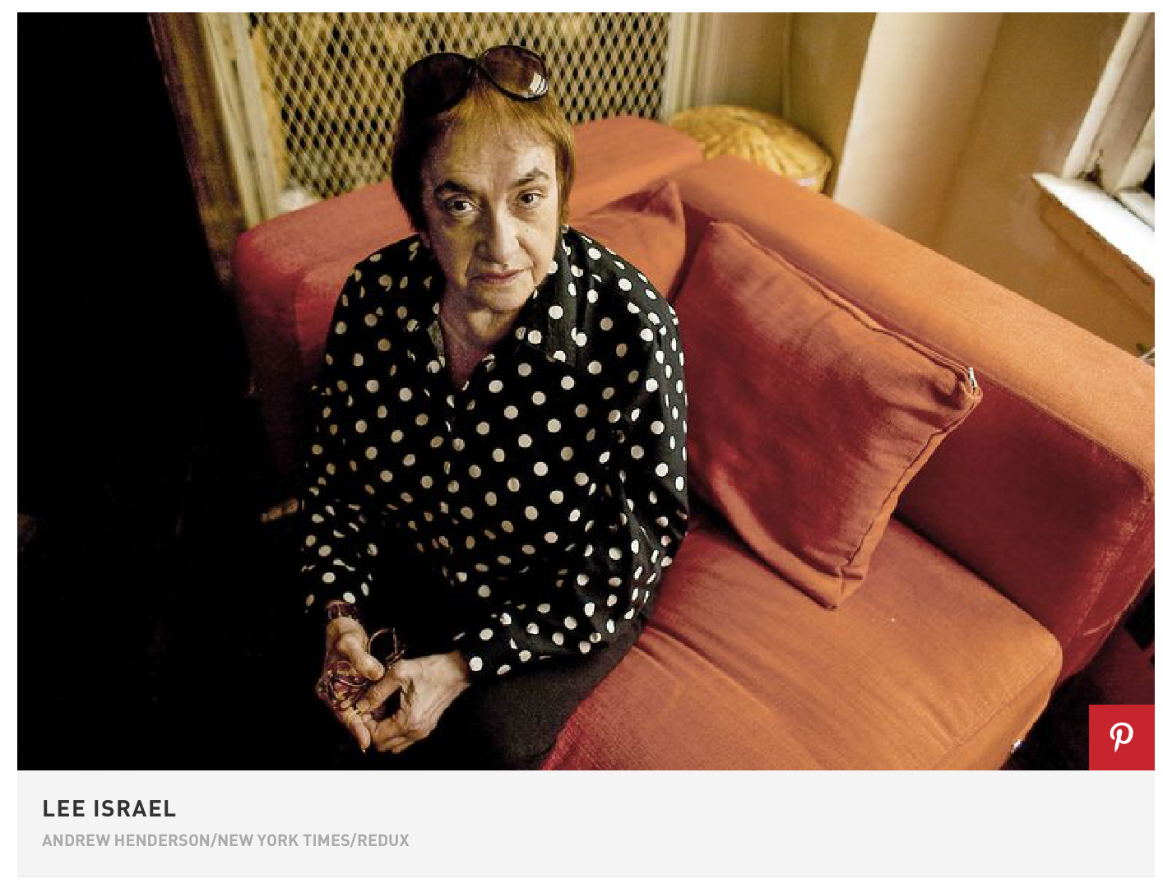
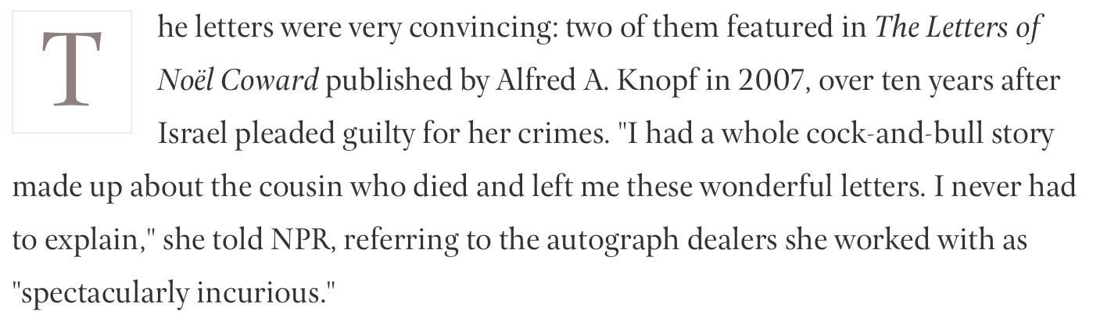
Alterations are not always so easily corrected
https://web.archive.org/web/20190225095314/https://www.townandcountrymag.com/leisure/arts-and-culture/a23084048/can-you-ever-forgive-me-lee-israel-true-story/

Slide 24
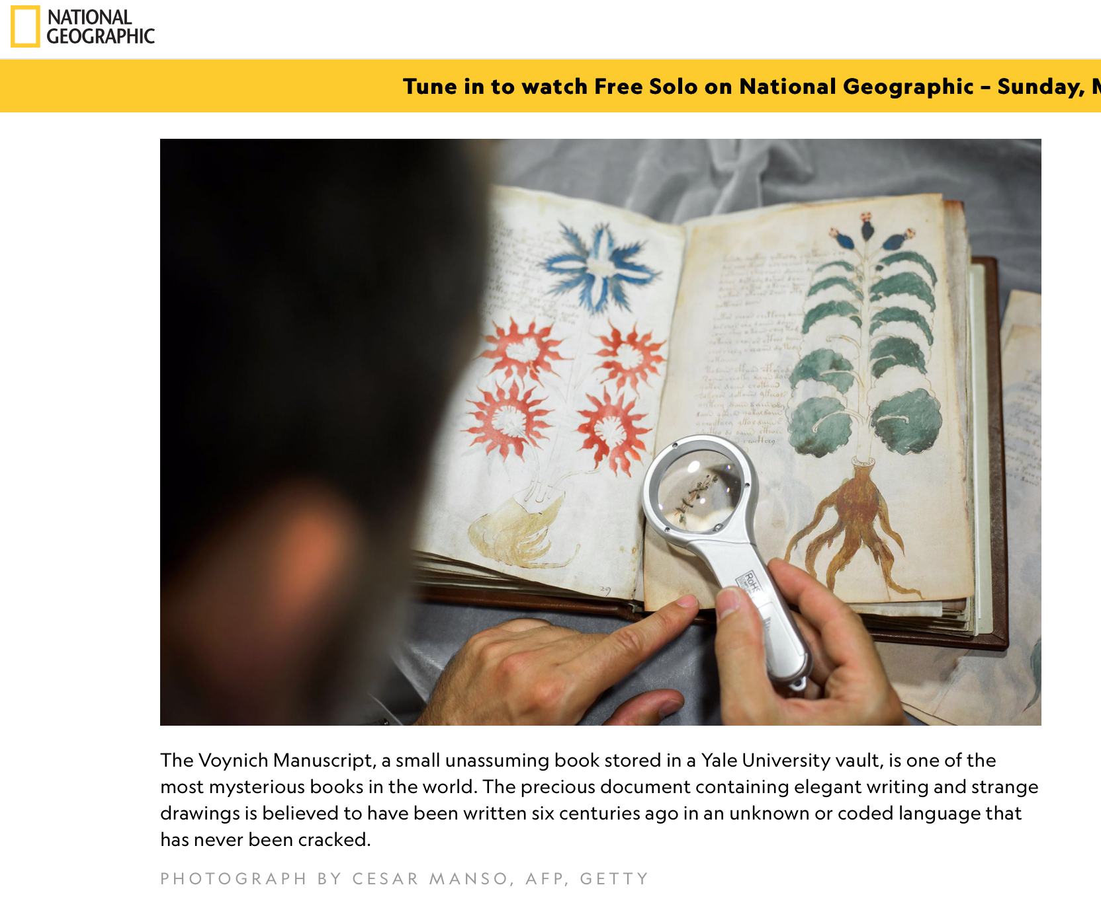
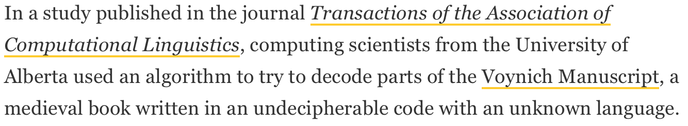
Historical forgeries can linger for centuries
https://web.archive.org/web/20190305214856/https://news.nationalgeographic.com/2018/02/voynich-manuscript-cipher-code-hebrew-europe-spd/

Slide 25
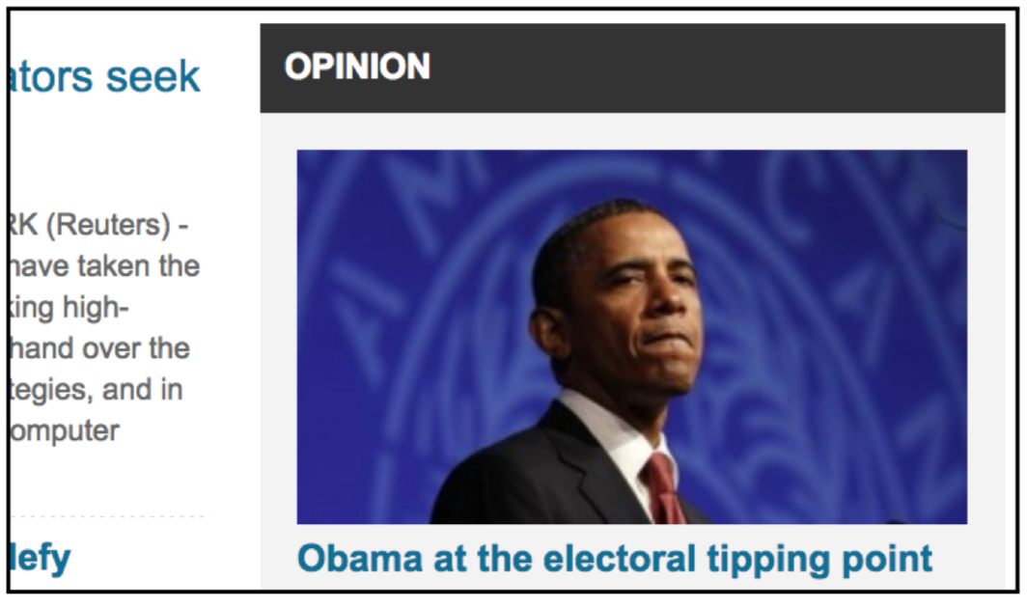
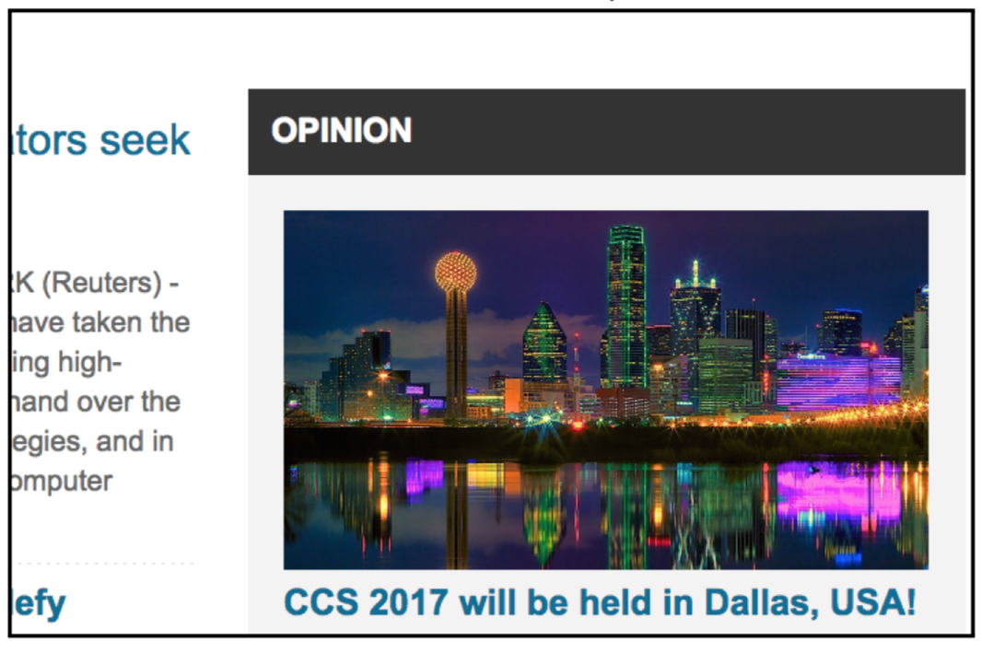
Changing the Archived Web from the Present
Lerner, Ada, Tadayoshi Kohno, and Franziska Roesner. "Rewriting history: Changing the archived web from the present." Proceedings of the 2017 ACM SIGSAC Conference on Computer and Communications Security. ACM, 2017.

Slide 26
Archives need a way to verify media has not been altered
“Independent of the efforts to document the capture of materials in a trustworthy way, the cultural memory sector must step up to the challenges of contextualizing media once it is created and disseminated. Registries are fairly straightforward, at least technologically. It's important to track chains of custody and provenance in ways that are transparent and secure.”
https://web.archive.org/web/20190128083058/https://er.educause.edu/articles/2018/10/managing-the-cultural-record-in-the-information-warfare-era

Slide 27
A four pronged approach to preserving cultural record
Documentation of provenance and chain of custody for archival data.
A lot of interest in distributed ledgers, or blockchain technology.
Current methods need to be more transparent.
Improved forensic tools for verifying authenticity of digital records.
DARPA is spearheading research in this area in regards to Deep Fakes.
Digitally signing media at time of capture as an aid to provenance.
Contextualization of fake news or falsified data.
Fakes are as much a part of the cultural record as legitimate news, but requires some sort of contextualization to understand why it was generated.

